Slide 1







IMMoRTALS
Interfaces, Models, and Monitoring for Resource-aware Transformations that Augment the Lifecycle of Systems
BBN Site Visit

Slide 2
Agenda
Program Review: 30 minutes
Technical approach, overall system architecture, goals, schedule, milestones, etc.
R&D Spotlight: 30 minutes (15 + 15)
1-2 interesting research problems and/or key technical issues currently being worked on
Phase 1 platform demonstration workshop: 15 minutes
Technical and programmatic plans/preparations
MIT-LL Interaction: 15 minutes
Impression w.r.t. challenge problems, evaluation, etc.
Looking ahead to Phase II: 15 minutes
CPs, Tech milestones)
Demo (s): 30 minutes
Tech transition: 15 minutes
Usability: 15 minutes
Conclusion, action items/break for lunch: 15 minutes

Slide 3
Program Review

Slide 4
Outline
Technical Approach
Goals (platform, domain)
Key concepts and assumptions
Approach
System overview
Phase 1 CPs
Summary of progress
Programmatics

Slide 5
IMMoRTALS Platform and Domain
IMMoRTALS Platform
Marti + ATAK light clients for sharing Situation Awareness (SA) information
IMMoRTALS Domain: Mission-specific tactical SA
SA Data (location, images, short text annotations)
Sharing (sending, receiving, storing)
IMMoRTALS Objective: Evolve the baseline application to varying missions
Changes in functional requirements
Changes in available resources in the target deployment environment
Initially in phase 1 changes are provided before deployment, changes detected in-mission will be addressed in phases 2 and 3

Slide 6

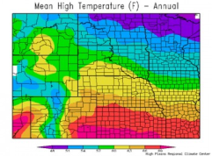
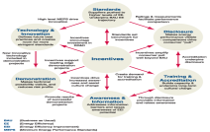
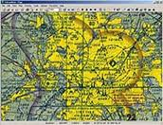
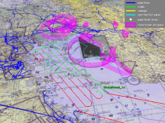
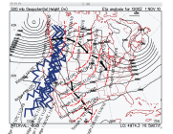

The Tactical SA Domain Offers a Rich Context for Program Evolution
Mission
ISR
Search and Rescue
Supply
Climate
Visibility, rain, wind
Temperature
Current & future
Policy
Organization policies
Operating procedures
Rules of engagement
Mission plans
Location
Geo coordinates
Terrain/buildings (images)
Surrounding
No contact, taking fire
Red/blue forces
Risk Estimated Distance
Location is Central to Tactical SA
Dimensions of mission-specific tactical situation awareness are adapted from Cognitive Radio Architecture Evolution, Mitola, IEEE, 2009
Equipment
Battery & load
Fuel
Ammunition
Movement
Tracks
Planned/observed routes
Velocity
SA applications running on mobile environments include, control, and are affected by these dimensions. Any ecosystem change that affects these can potentially break the SA apps.
As an example that is generalizable to other dimensions, location is a core tactical SA attribute that ecosystem changes are likely to affect over the life of the SA application.
Notes:
Some of the dimensions that the warfighter considers when they build their own mission specific operational picture.

Slide 7
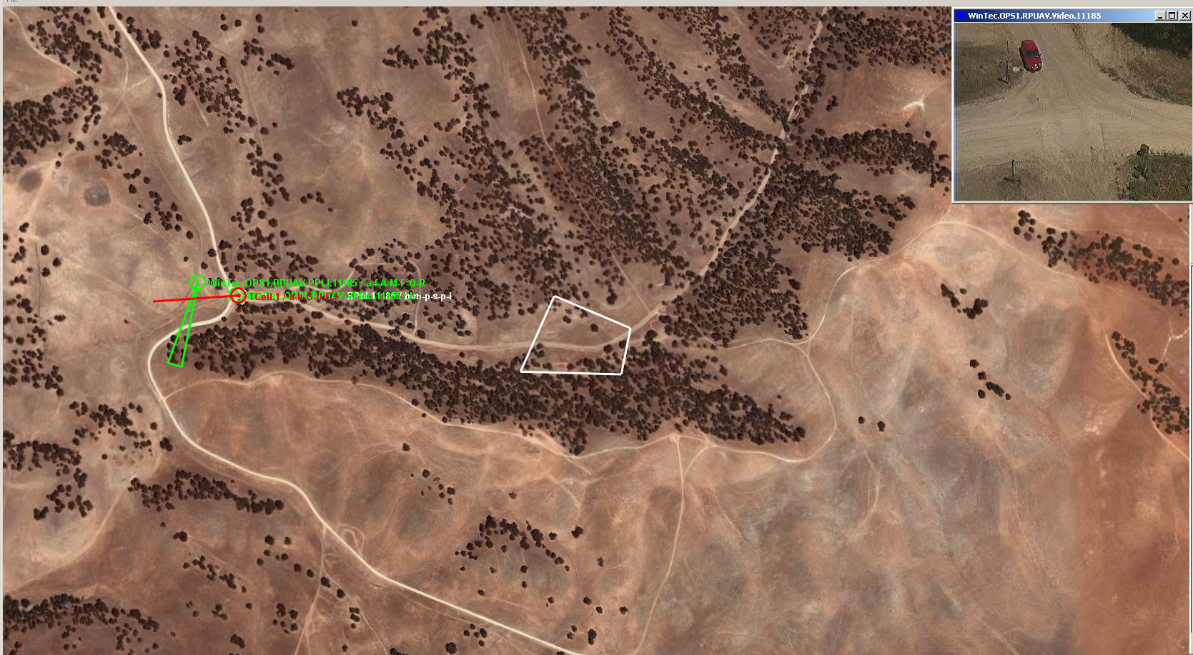




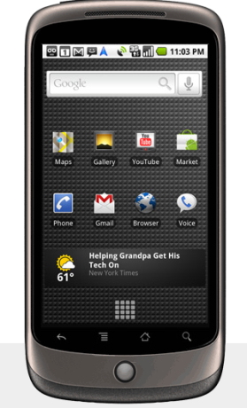
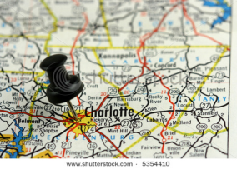
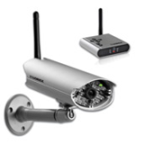


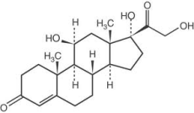


Example Mission, Supporting SA Data & Hardware/Software Resources
Mission: Extract NGO aid workers who are being threatened by insurgents in a village.
Historical Databases
Tasks in Achieving Mission Goals
Data Sources & Assets
Identify friends & relevant info (e.g., visual id, languages)
Understand prior interactions with friends & leaders
Locate/track friends, enemies, & victims
Find layouts of streets, landmarks
Identify potentially “safe” & “unsafe” locations
Annotated text, pictures, video, geo-location data
Plan safe, alternative, ingress & egress routes
UAV video feed, sensor information, handsets, location data
Communicate with nearby units, base stations
Reachback to command centers, support (air/naval)

Slide 8

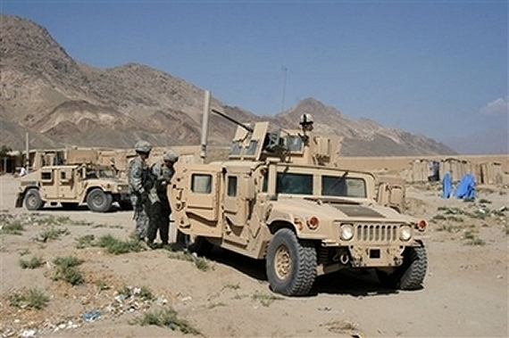
Baseline Application and Example Changes
Mission: Extract NGO aid workers who are being threatened by insurgents in a village.
Historical Databases
Tasks in Achieving Mission Goals
Data Sources & Assets
Identify friends & relevant info (e.g., visual id, languages)
Understand prior interactions with friends & leaders
Locate/track friends, enemies, & victims
Find layouts of streets, landmarks
Identify potentially “safe” & “unsafe” locations
Annotated text,
pictures, video
geo-location data
Plan safe, alternative, ingress & egress routes
UAV video feed, sensor information, handsets, location data
Current SA application works with handhelds coordinated with a server over IP and assumes unobstructed GPS
Communicate with nearby units, base stations
Task 1
Task 2
Problem: What if the mission is set in a canopied jungle, or the adversary has the ability to spoof GPS?
Problem: What if the mission is set in a network challenged environment, and has a large number of participants?

Slide 9
Key Concepts and Assumptions
Concepts
Granularity – DFUs
RDF knowledge repository
Basic mutation operations: replace, add, delete
Offline source code evolution and online hot swap/bytecode rewriting
Assumptions
What is given to us: functional spec
What are we deriving/inferring: extra-functional (dependency, usage)
Control Points: derived from PLA; parts of the code that have functional spec defined (and thus are adaptable)

Slide 10
Two Flavors of Change Handling
Baseline
New mission
requirement
New target
environment
Library Update
HW Update
time
Offline, pre-deployment adaptation
…
The baseline application evolves in response to changes resulting in program variants (different source code and binary) to be deployed. This evolution happens offline, i.e., the new binary needs to be deployed to take advantage of the adaptation. The changes in code include substitution, addition, removal of code elements.
Changes in the
operating
environment
Online, runtime adaptation
Or
Or
behavior
instrumentation
The deployed application alters its behavior or alters its binary to preserve the behavior or alters both its binary and behavior in response to the change. This evolution happens online, i.e., when the application is used in mission. May need additional instrumentation to be present in the deployed binary (the black oval )
Notes:
Note that in the top panel the env and mission req changes forces modification of the source code
In the bottom panel– changes are in the operating env– i.e., changes are detected when the application is in operation. These changes are accommodated either by adjusting the behavior of the running application, or by altering the binary facilitated by the instrumentation component that was part of the running application.
Note- altering the behavior– by programming against the anticipated change, or by putting in a QoS-aware adaptive MW– was what we did in the past, and we do not want to focus on in this project. Our run time adaptation will be through transforming or rewriting the binary/bytecode or hots wapping the binary.

Slide 11




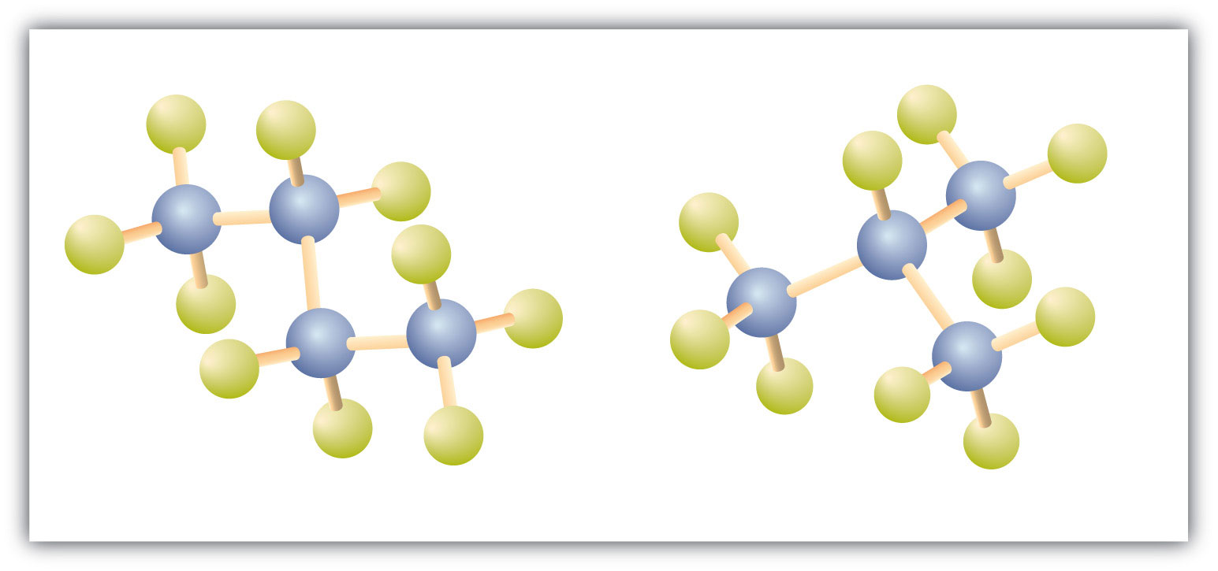
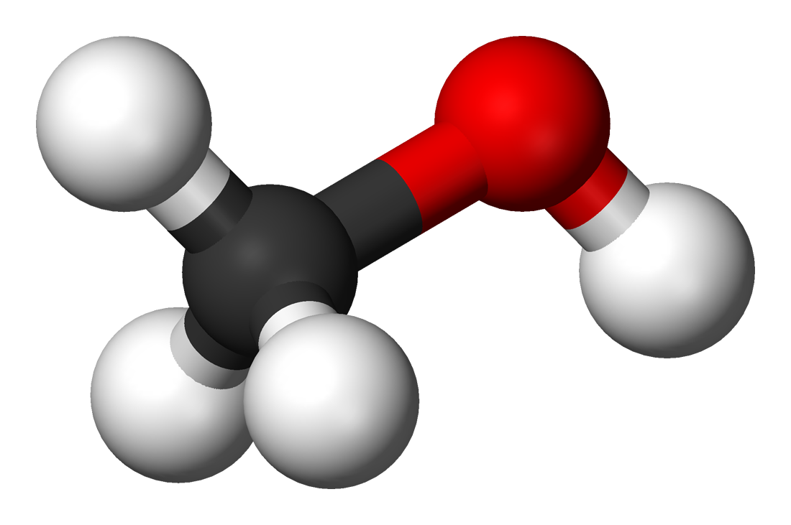




Approach: Deriving Program Evolution
Deriving what needs to change in the program involves reasoning about the program and the trigger
The trigger could be a “change request” or an “observed or detected change”
Usually, observed/detected changes → runtime
Changes observed at runtime may result in offline (outside of the executing mission) adaptation (e.g., modifying source code to create new binary that is then hot swapped)
Of course, requests to support new deployment environment or modified functionality are offline change drivers
Reasoning takes place in “knowledge space” – i.e., in terms of abstract representation of code, resources, their relationships
DAS workflow uses
SPARQL queries over Triple store: identify candidates for adaptation
Resource DSL (refinement and variational types): quickly evaluate combinatorial space of adapted systems
Essentially, algorithmic use of the combined power of SPARQL and Type system
Change request
Reasoning and Analysis
Detected changes
DAS machinery
knowledge
Source code
Code massaging
Adapted code

Slide 12
Approach: Deriving Evolution (contd)
What is in the knowledge space:
Domain knowledge
Currently, high level/global/axiomatic rules, e.g.,
If resource R is contested, reduce consumption of R
May need domain-specific (e.g., tactical SA) specific refinements or concretizations e.g.,
Bandwidth consumption depends on SA message size
Sufficient knowledge about functional and extra-functional specification of
The (baseline) application:
Functionality: Definition, Use, Usage Pattern
Extra functional: Resource dependency, Resource usage
Ingredients/raw material for adaptation – code that transforms domain-specific data types, domain-specific functions: similar functional and extra functional description
Simplifying assumption: not every line of the baseline is adaptable – we are demonstrating the technology for a specified subset (control points)
End to end flow
Model → Knowledge Extraction → Change Request → Evolved Application: More later in the context of the demo
Reasoning
Guided search with constraint satisfaction, type checking, and type selection
Declaration of X*
Definition of artifact X
DFU
Control Point1
Other uses of X
Definition of artifact Y
Control Point2
Other uses of X and Y
DFU
Declaration of Y*
Currently Java objects, so definitions are classes
DFU s could generalize to artifacts other than classes
Application Code
For control points, the intended use of the objects, and the functional and extra functional specification of the code implementing them are available
Note:
functional → given,
extra-functional → discovered

Slide 13
IMMoRTALS System Overview
IMMoRTALS code base, build and test environment
Error report, deploy/update SW
IMMoRTALS Management Network
Host
Ecosystem
SA producer & consumer
Brokering and Storage
IMMoRTALS back end
Operational Network
Server Host
Android
Ecosystem
Ecosystem
Android Clients
Linux/Java Server
Backend
Deployed/running platform application
Change detection tools
Runtime management tools
Program synthesis tools
Build tools
Validation tools
Program analysis tools
Repo
y

Slide 14
Phase 1 CPs
Driven by changes in functional (e.g., mission requirement) and extra functional (e.g., resources) requirements and constraints
Evaluation is focused on correctness (i.e., it is mostly verification)—no qualitative distinction is made among the possible solutions
Verification is through tests to show that functional intent is preserved
Realized by substitution of components that follow the same usage pattern as baseline
Substitute(s) that could work exists: choose the substitute & transform the code to accommodate naming and signature differences, and other dependencies (code massaging)
Compose a substitute from available components, and then massage the code
Construct the substitution candidate (DFU) from an existing DFU and mix in aspects from another DFU

Slide 15
CPs and the SA Mission Relevance
Challenge problem 1 is focused on Location/Location Provider
Variations in environment:
Desert: GPS is available
Jungle under canopy: GPS unavailable (leaves block radio signals)
Indoors: GPS unavailable
Variations in mission requirements:
Any location where adversarial GPS-spoofing is expected: trusted GPS required
Challenge problem 2 is focused on contested resource (such as network bandwidth in our current version)
Number of clients
Network capacity (various mesh networks vs. cellular 3G vs. 4G)

Slide 16





CP 1: Respond to Mission Requirement Changes
Problem 1: New mission requires location information that can be trusted. Baseline application uses a location provider that is commercial grade. Components that provide more accurate and authenticated location information can be found. How to modify the baseline code to work with trusted location provider?
: Commercial Grade
: Accuracy <Low>
: Untrusted
Change request:
Mission needs
Accurate and
trusted location
: Military Grade
: Accuracy <High>
: Trusted
: Commercial Grade
: Accuracy <High>
Rest of the Program
Location Provider
Available components (analyzed, modeled)
Current application
Shapes do not imply exact signature match: some code massaging may still be needed to compile and run
Notes:
What is the right user interface that can support this capability?
During what phases of the mission can these capabilities be used?
How do we evaluate the usability of this capability?

Slide 17


CP1: Substitute and Massage the Code
Solution: Represent relevant semantics of the location providers and the use of the location provider in the application. Infer resource dependency and resource usage of location providers and augment the models. Identify candidate location providers that offer the desired properties. Substitute the existing location provider, managing any differences in signature (the function names and argument order may be different) and functional dependencies (initialization, imports, etc.). Evaluate resource usage, build and test.
Rest of
the Program
Mutated application
Location Provider
Available components (analyzed, modeled)
Notes:
Warfighter & Mission Context
who
what
when
why

Slide 18
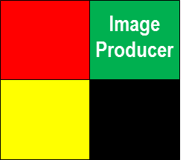
CP 2: Respond to Mission Requirement and Target Environment Change
Problem 2: New mission is in a bandwidth restricted environment. The new mission handles the same SA data as the baseline (images), but has a different number of clients publishing at a different rate from the baseline (which was 1 publisher and 1 subscriber). How to modify the baseline so that the new variant provides acceptable performance?
Bandwidth footprint
Change request:
Message frequency
Available bandwidth
Image Producer
Image transformers
Current application
Other image producers
Notes:
What is the right user interface that can support this capability?
During what phases of the mission can these capabilities be used?
How do we evaluate the usability of this capability?

Slide 19
CP 2: Synthesize and Add Code That Relieves the Pressure on Bandwidth
Solution: As before, semantic and resource specification is in the model space. Resource DSL type checking reveals that with the mission parameters (num. clients, publication size and frequency), the bandwidth requirement will exceed what is available. Further analyses of the models reveal:
The function that sends SA data uses bandwidth and amount of data put on the network is correlated to the SA data being sent
Code exists that compresses objects or transforms images
Compose compression or image transformation with SA data, and massage code to address syntax and functional dependency. Re-evaluate resource usage, build and test as before
: Size of image produced
→
: Scale factor
New bandwidth footprint
Composed Image Producer
Adapted application
: Size of image produced
Use substitution
Notes:
Warfighter & Mission Context
who
what
when
why

Slide 20
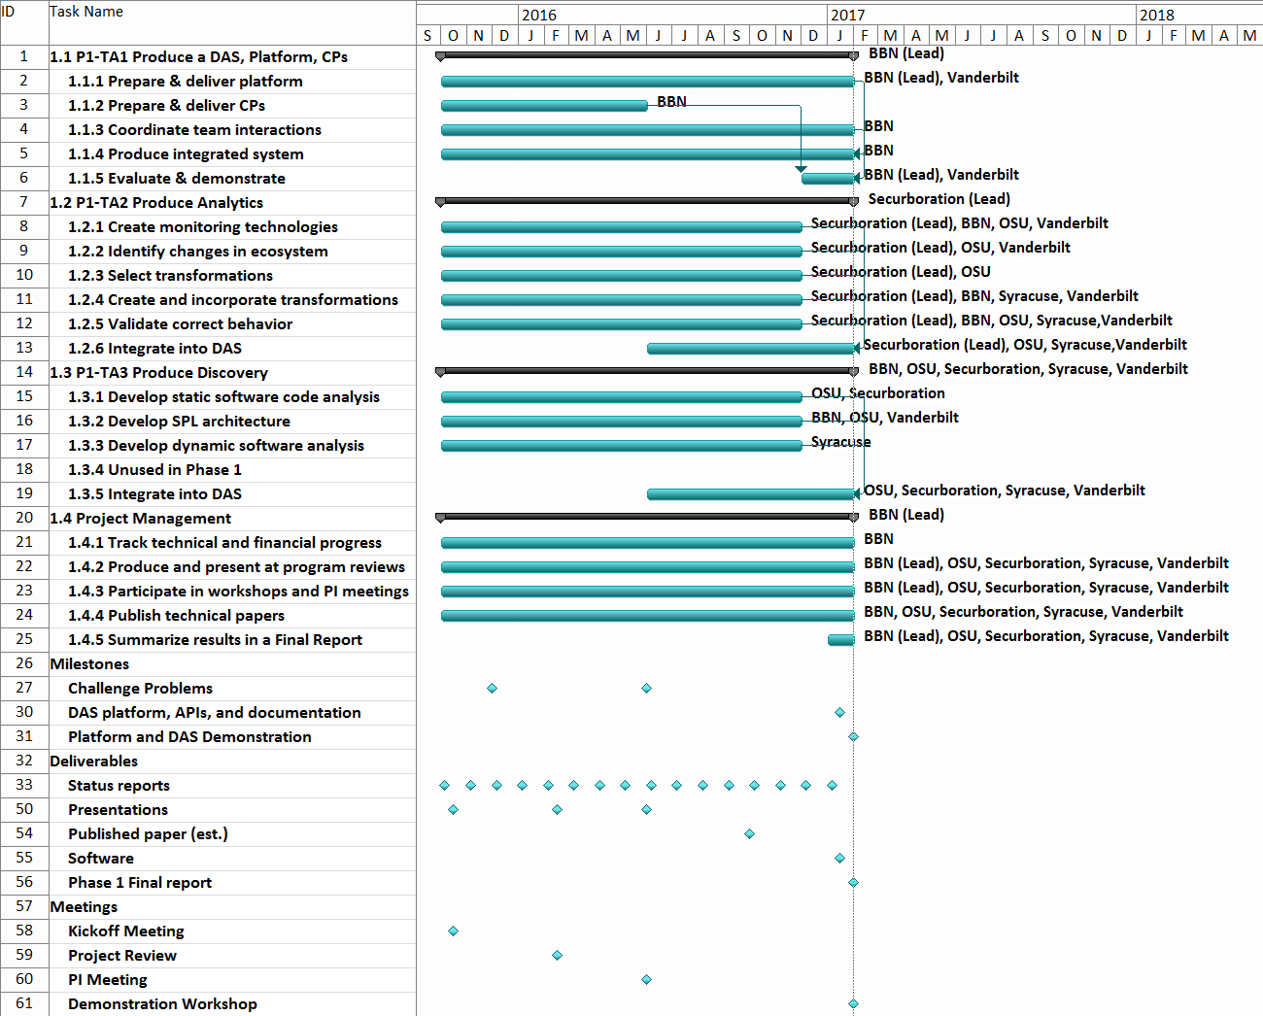
Programmatics
We are here

Slide 21
Program Status/Summary of Progress
Platform Instantiation
Challenge Problem Definition
Reasonably complete
Vocabulary/Ontology
Environment Model
Program Analysis
Ongoing work, initial capabilities developed
Resource DSL
DAS
CP in DAS
Completed for Phase 1
Adaptation/CP Enhancements
Apr Site Visit End to end Demo
We are here
Publications:
7 accepted
7 more in submission
Developed a CONOPS package
We are continuing to improve the CP system – e.g., use real android devices instead of emulator
Notes:
Note for the speaker: Stood up the platform, published the two CPs, have a vocabulary to represent the functional and extrafunctional aspects of the program and the ecosystem, have initial capabilities for program analysis to discover resource dependency and usage, DSL for checking, working DAS v1– not pretty looking or with nice interfaces– in process of integrated the upgrades of the components, CP1 working in the DAS v1, CP2 is in process, and also already started looking an enhancements to CPs that will stretch the limits of current analysis and synthesis capabilities. And started publishing..
List of publications

Slide 22
Major Achievements
Vocabulary and KR
Model of models
Instance proof for substitute and compose
DSL for type checking
Inferring HW/SW dependency and CPU and Memory usage
Mutation testing

Slide 23
R&D Spotlight

Slide 24
IMMoRTALS R&D Areas
Extracting and representing knowledge about software
To enable programmatic reasoning and exploration
Resource usage inference by program analysis
Feeds to the KR task
Resource types and DSL
Type checking, Type selection, and Type choices
Efficient and novel use of mutation testing
Hierarchical delta debugging with additional program understanding to realize reduce and replace transformations
Schema independent query system
Evolve code that depends on database view or schema when the view or schema changes
Model of models
The KR and analysis is built on a certain world view, what if that changes?
Transformation of code
Robust and systematic realization of the replace, reduce and compose primitives
Make our approach to substitute or synthesize DFUs transferable
Extend the applicability of these primitives
Notes:
KR: Jacob’s stuff, vocabulary– distinction between semantic (what does this piece of code do) and resource related (what does it depend on, what does it use, how much is needed to function) knowledge. Depends on program analysis for the resource part, and the human developer for the semantics part. This is also a candidate for transition– if there is a good visual explorer of the KB, human maintainers of ATAK/TAK server will benefit in debugging, and handling change requests.
Resource usage inference: UCR, the hard problem here is that in many cases resource usage depends on other factors like inputs, transitivity and external factors. For example, how much bandwidth is used by a single attack client depends on the size of images being sent, how frequently they are being sent (these are highlighting dependency on inputs) but also whether there was a image transformer between the sensor and the actual sensor (this is highlighting the transitivity issue). Similarly, at the server side, which is responsible for disseminating the images, in addition to input and transitivity, bw consumption will depend on how many clients are there. How do we discover these dependencies? Is program analysis (static, dynamic, concolic…) enough? Can this be combined with testing, mutation testing etc? This is the R&D agenda this area is pushing.
Resource types: Checking: is this a valid assignment. Selection: find a valid assignment from available choices. Choice: find the best choice, based on some criteria
Eric W/student are working on this. The idea is to check, select, choose the DFU such that the resource requirements and resource availability can be analyzed as type analysis. This gives a formal backing for transformations/mutations that the IMMoRTALS DAS performs.
Efficient and novel use of mutation testing: this is Alex and Arpit, the questions we are trying to answer are as follows.
Can we use mutation testing to discover dependency that perhaps is not possible to find by program analysis. How efficiently can we discover these dependency, what kind of dependencies can this technique discover?
Can we find a reduced version of a program that preserves the semantic spec and mission requirement of the program, and how can we make this more efficient. Especially, if we want to reduce the dependency on labeled tests, what additional information and in what form, can we make use of? Can we extend this technique to do something other than reduce, e.g., substitute?
Schema independent query system– This is Arash’s work. The idea is that in many cases SA data is persisted in a DB, and the schema of the tables are changed for performance or other reasons (e.g., merging two tables, splitting a table etc). The goal of this R&D thrust is to learn to rewrite the queries against the new schema by looking at the current queries, current schema and the answers they return. Question for Arash: I know it is a different problem, but the audience may ask will you handle addition or deletion of columns, or changing types of the columns (say mm-dd-yy to mm-dd-yyyy, string to number etc)
Model of models: For KR and analysis of the represented facts, we have assumed a certain model of things, E.g., an android application consists of A B and C. It is impractical to assume that model will remain valid for a long time. Sooner or later that model will change/evolve. What happens then? This is the area that Fred is working on.
Systematic transformation of code: this to make our approach to substitute or synthesize DFUs more transferable– i.e., to make it work in more contexts, relax some of the architectural assumptions that it works only for this pattern (init-use-destroy) or a pipleline structure, can we get it to work in binary and byte code? This is an area that BBN is looking at. Have interaction with the mutation testing work.

Slide 25
Semantic Modeling and Knowledge Representation
Jacob Staples

Slide 26
Technology gaps addressed
How can we help developers specify the semantics of code they write?
How can we extract/infer useful information about resource use from compiled artifacts that can be used to evolve when something breaks?
How can knowledge from the various TAs be normalized for use in code synthesis/evolution?

Slide 27
What we’ve done
Created vocabulary backing a semantic specification and useful for describing scaffold code structures
Created a vocabulary for making assertions about the state of software and the ecosystem in which it executes
As they exist (descriptive)
(observed 256kbps EWMA on a network link over a 10s sliding window)
As they should exist (proscriptive) - describe problematic conditions and their implications
(bandwidth exceeded results in a constraint violation)
How to correct problematic conditions (prescriptive) - when some constraint is violated, how can it be corrected
(if a bandwidth limit is exceeded, try reducing the size of data transmitted across the network)

Slide 28
What we’ve done (cont.)
Created toolchains for
Building or extending domain ontologies using POJOs
Building scaffold (structural) models of arbitrary bytecode
Auto-generating programmer-friendly annotations that link to the semantic specification vocabulary
Discovering semantic spec annotations in compiled code and overlaying the resultant concepts on the scaffold

Slide 29
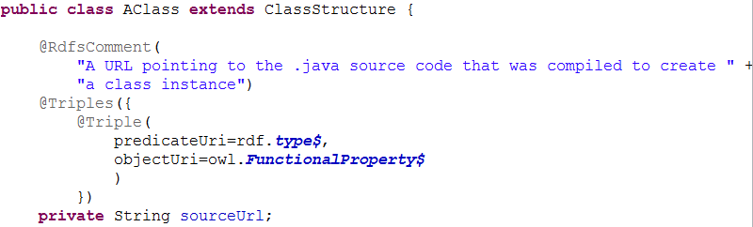
Toolchain showcase Ontology generator
Enables developers to rapidly build, populate, or extend existing ontologies using POJOs

Slide 30
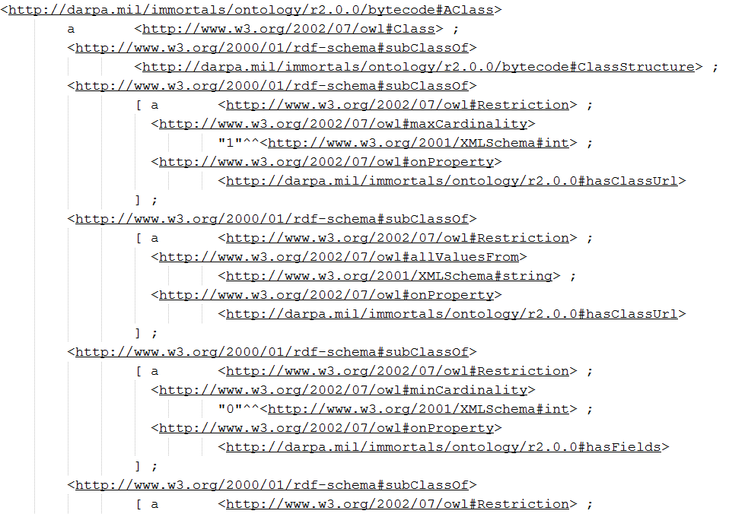
Toolchain showcase Ontology generator
Enables developers to rapidly build, populate, or extend existing ontologies using POJOs
Schema gen

Slide 31
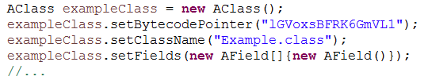
Toolchain showcase Ontology generator
Enables developers to rapidly build, populate, or extend existing ontologies using POJOs

Slide 32
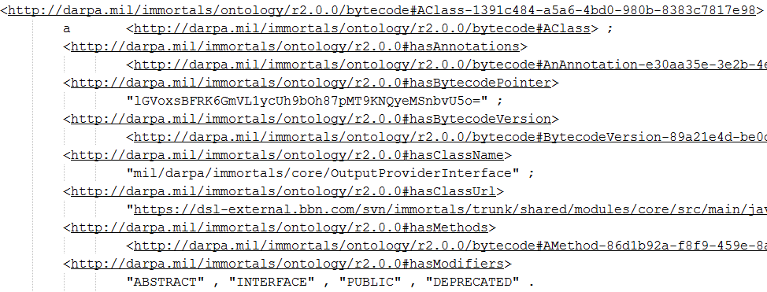
Toolchain showcase Ontology generator
Enables developers to rapidly build, populate, or extend existing ontologies using POJOs
Instance gen

Slide 33
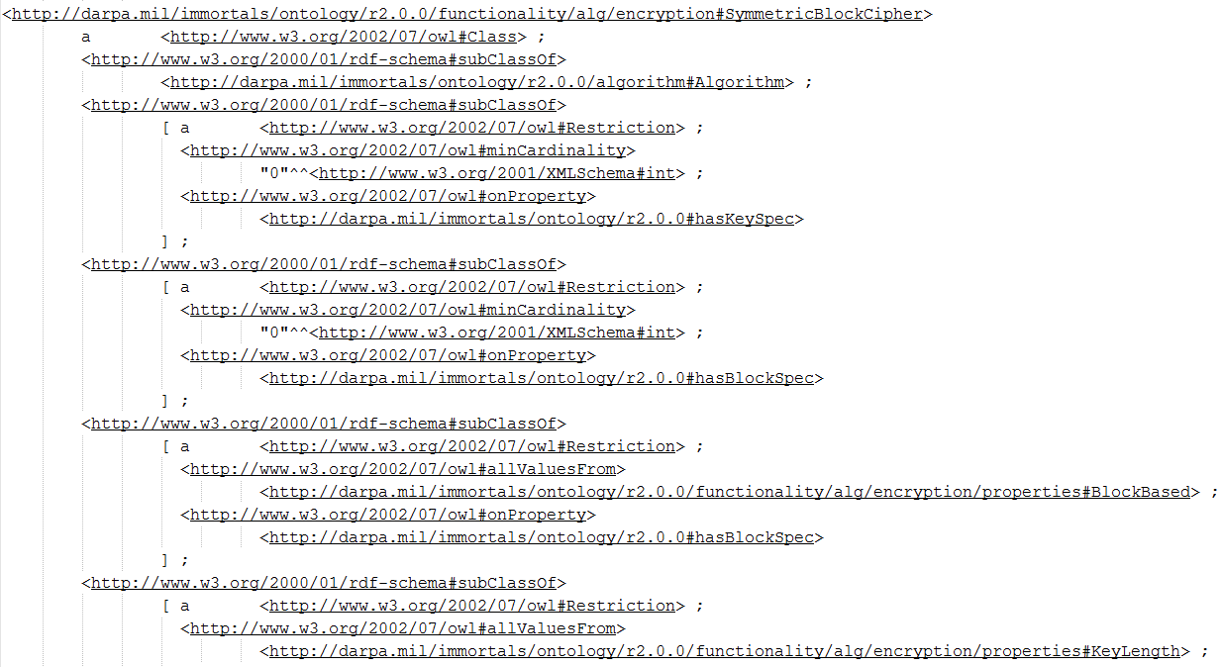
Toolchain showcase Annotation generator
From existing ontology…

Slide 34
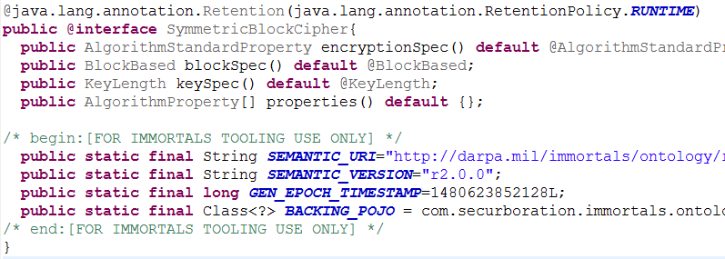
Toolchain showcase Annotation generator
…generate programmer-friendly annotations

Slide 35
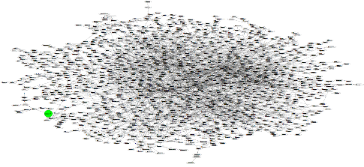
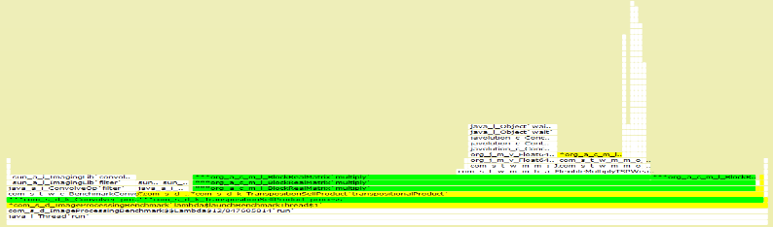
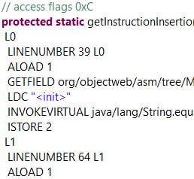
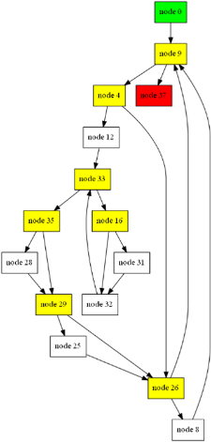
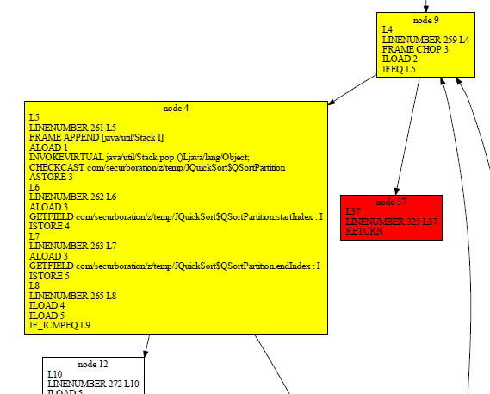
Toolchain showcase Scaffold abstractions
Dynamic analysis
abstractions
Call graph
Call trace
Compilation
abstractions
JAR
Class
Method
CFG
f
g
Basic block
p
q
Instructions
Static analysis
abstractions

Slide 36
Knowledge extraction overview
Code repo
Input option 1: complete Java project
Provided: vocabularies
.gradle
.java
Bytecode
structure
Semantic spec
.java
.java
Input option 2:
compiled bytecode
Artifact repo
jar
jar
jar
Bytecode analyzer
Resource
overlay
Semantic spec
overlay
Resource1
task1
Scaffold model
Structure +
control/data flow analysis
Resource2
task2
Resource3
task3

Slide 37
Knowledge extraction overview
Code repo
Input option 1: complete Java project
Provided: vocabularies
.gradle
.java
Bytecode
structure
Semantic spec
.java
.java
Input option 2:
compiled bytecode
Artifact repo
jar
jar
jar
Bytecode analyzer
Resource
overlay
Semantic spec
overlay
fs read
loadImage
Scaffold model
Structure +
control/data flow analysis

Slide 38
Knowledge extraction overview
Code repo
Input option 1: complete Java project
Provided: vocabularies
.gradle
.java
Bytecode
structure
Semantic spec
.java
.java
Input option 2:
compiled bytecode
Artifact repo
jar
jar
jar
Bytecode analyzer
Resource
overlay
Semantic spec
overlay
fs read
loadImage
Scaffold model
Structure +
control/data flow analysis
lossyTransformation(Resize)

Slide 39
Knowledge extraction overview
Code repo
Input option 1: complete Java project
Provided: vocabularies
.gradle
.java
Bytecode
structure
Semantic spec
.java
.java
Input option 2:
compiled bytecode
Artifact repo
jar
jar
jar
Bytecode analyzer
Resource
overlay
Semantic spec
overlay
fs read
loadImage
Scaffold model
Structure +
control/data flow analysis
lossyTransformation(Resize)
Hardware accelerator?
losslessTransformation(Encrypt)

Slide 40
Knowledge extraction overview
Code repo
Input option 1: complete Java project
Provided: vocabularies
.gradle
.java
Bytecode
structure
Semantic spec
.java
.java
Input option 2:
compiled bytecode
Artifact repo
jar
jar
jar
Bytecode analyzer
Resource
overlay
Semantic spec
overlay
fs read
loadImage
Scaffold model
Structure +
control/data flow analysis
lossyTransformation(Resize)
Hardware accelerator?
losslessTransformation(Encrypt)
network
interprocessDataflowLink(wireHttp)

Slide 41
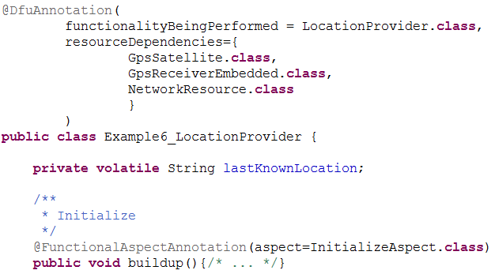
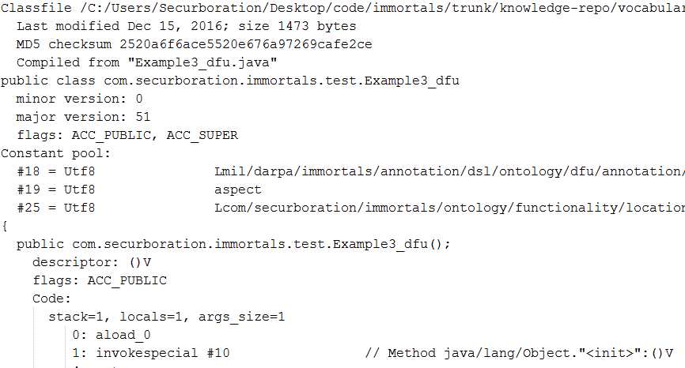
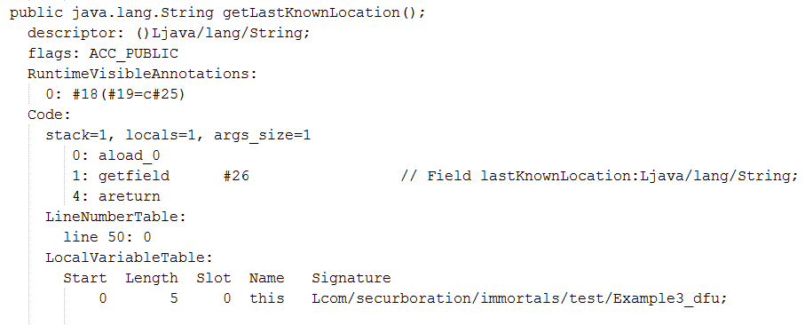
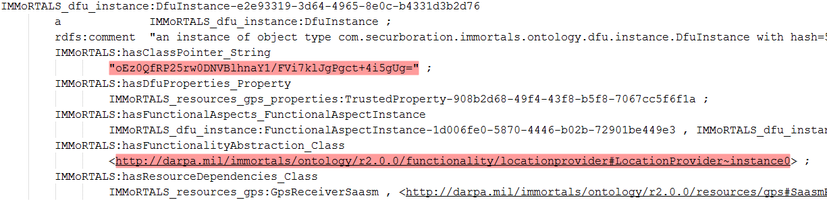
Toolchain showcase Annotation-based semantic spec
compile
bytecode
parse
knowledge

Slide 42
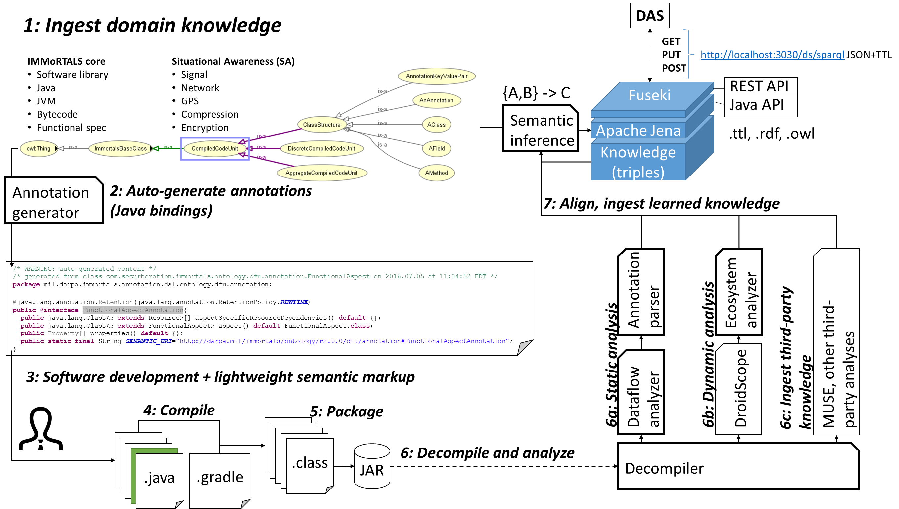
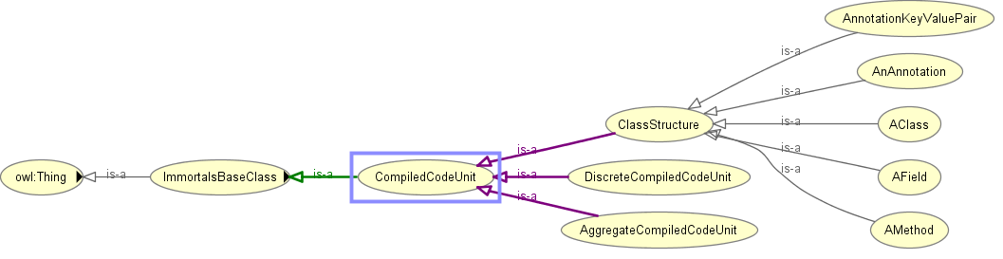

Knowledge repository CONOPs
1: Ingest domain knowledge
DAS
GET
PUT http://localhost:3030/ds/sparql JSON+TTL
POST
IMMoRTALS core
Software library
Java
JVM
Bytecode
Functional spec
Situational Awareness (SA)
Signal
Network
GPS
Compression
Encryption
{A,B} -> C
Fuseki
REST API
Apache Jena
Java API
Semantic
inference
Knowledge (triples)
.ttl, .rdf, .owl
Annotation
generator
2: Auto-generate annotations
(Java bindings)
7: Align, ingest learned knowledge
/* WARNING: auto-generated content */
/* generated from class com.securboration.immortals.ontology.dfu.annotation.FunctionalAspect on 2016.07.05 at 11:04:52 EDT */
package mil.darpa.immortals.annotation.dsl.ontology.dfu.annotation;
@java.lang.annotation.Retention(java.lang.annotation.RetentionPolicy.RUNTIME)
public @interface FunctionalAspectAnnotation{
public java.lang.Class<? extends Resource>[] aspectSpecificResourceDependencies() default {};
public java.lang.Class<? extends FunctionalAspect> aspect() default FunctionalAspect.class;
public Property[] properties() default {};
public static final String SEMANTIC_URI="http://darpa.mil/immortals/ontology/r2.0.0/dfu/annotation#FunctionalAspectAnnotation";
}
Annotation
parser
Ecosystem
analyzer
MUSE, other third-
party analyses
6c: Ingest third-party
knowledge
6b: Dynamic analysis
6a: Static analysis
3: Software development + lightweight semantic markup
Dataflow
analyzer
DroidScope
4: Compile
5: Package
.java
.java
.java
.java
.java
.java
.java
.class
JAR
6: Decompile and analyze
Decompiler
.java
.java
.gradle

Slide 43
Current limitations
Ontology generator
Doesn’t handle node R-valued triples (fundamental limitation of annotations, workarounds possible)
Annotation generator
Doesn’t handle polymorphism nicely (fundamental limitation of annotations, workarounds possible)
Vocabulary
Need to refine top-level vocabulary through integration of additional domains
Bytecode analysis
Structure/static analysis are quite robust! We’ve ingested hundreds of third-party JARs without issue

Slide 44
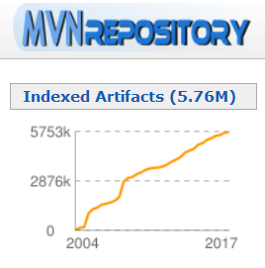
Possible extensions and applications
Create lint tools for sanity checking programmer use of annotations and domain POJOs
Move away from artifact-based build scripts
Simply specify semantic spec and the toolchain will pick an appropriate artifact (or subset of the artifact!) for you
Index a large repository of Java artifacts (e.g., MvnRepository)
Text mining/clustering on project descriptions to approximate spec (good enough for ‘jar Y does encryption’)
Code synthesis using only semantic models

Slide 45
Resource Usage Inference via program analysis
Yue Duan, Heng Yin
University of California, Riverside

Slide 46
Problem Statement
Given an Android/Java application, we would like to infer fine-graind hardware and software resource usage information at DFU level.
To know how applications could function normally under envrionment changes, we need to understand the resource requirements for each of its components.
Resource usage information is essential for generating resource profiles and annotating DFUs for later steps in the whole project.

Slide 47
Overview
Challenges
identify hardware resource dependency
quantify resource uages
input dependent resource usage analysis
input value
input size
Benefits:
understand what kinds of resource are required for each DFU
hardware resource such as GPS satelite
software resource such as third-party libs
know how much resource is needed in order to execute DFU
how much memory is needed to run one DFU
perceive how data is transitted accross DFUs and non-DFUs
extract resource usage information in a more accurate fasion by considering input size and value
image size will affect resource usages a lot given a image processing app
different input values may lead the app executing different paths resulting in a completely different resource usages

Slide 48
Overview
To address the aforementioned challenges, our whole system is designed to have three different subsystems (DroidScope, Symbolic execution and DroidSIFT) to perform four analyses.
The results are post-processed and eventually stored in our triple store for future query.

Slide 49
Approach
Resource dependency
Goal: understand what resources are used by DFUs
identify sensitive APIs related to certain hardware, e.g. android.bluetooth.BluetoothAdapter.getAdapter() for bluetooth
one-time effort, from our domain knowledge about Android
analyze the application statically with domain knowledge to infer hardware resource dependency
Resource usage quantification
Goal: quantify certain hardware resource usages
pinpoint hooking points during execution for resource usage quantification
for example
hook each instruction for CPU usage info
hook memory allocation function for memory usage info
achieve fine-grained usage analysis at function level or DFU level
may suffer from code-coverage issue

Slide 50
Approach
Impact of input size
Goal: evaluate how input size affects resoure usages
run the application against multiple inputs with different sizes
inputs are currently generated manually case by case
collect resource usage information for each input
evaluate the impact of input size for resource usages by modeling the results
Impact of input value
Goal: understand how input value affects application execution and resource usages
use symbolic execution and condition anlaysis to understand the code coverage of each individual input
understand how different execution paths could affect resource usages
research focus for the next phase

Slide 51
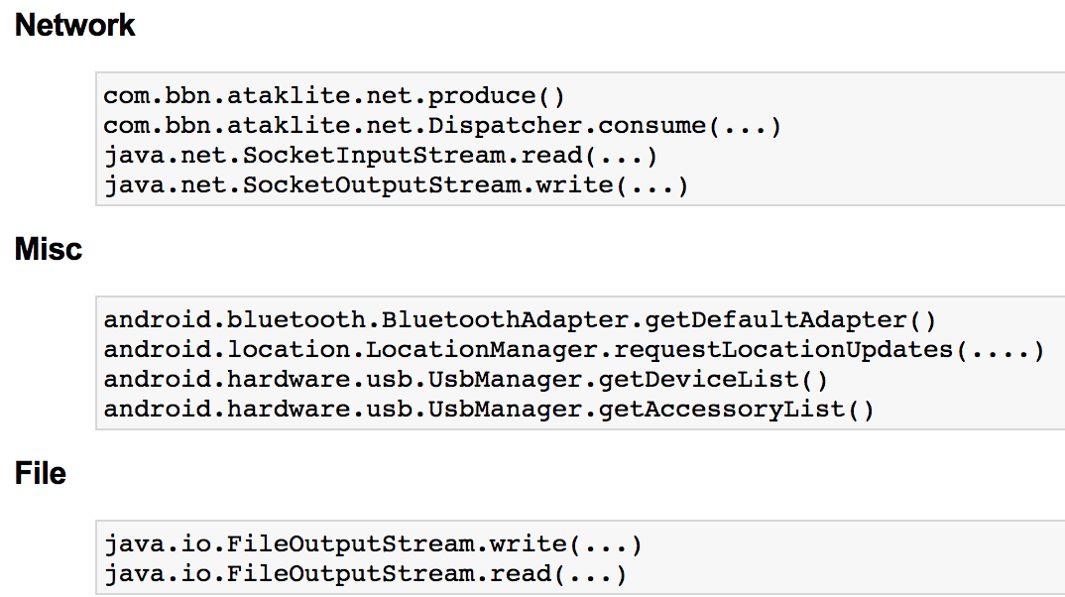
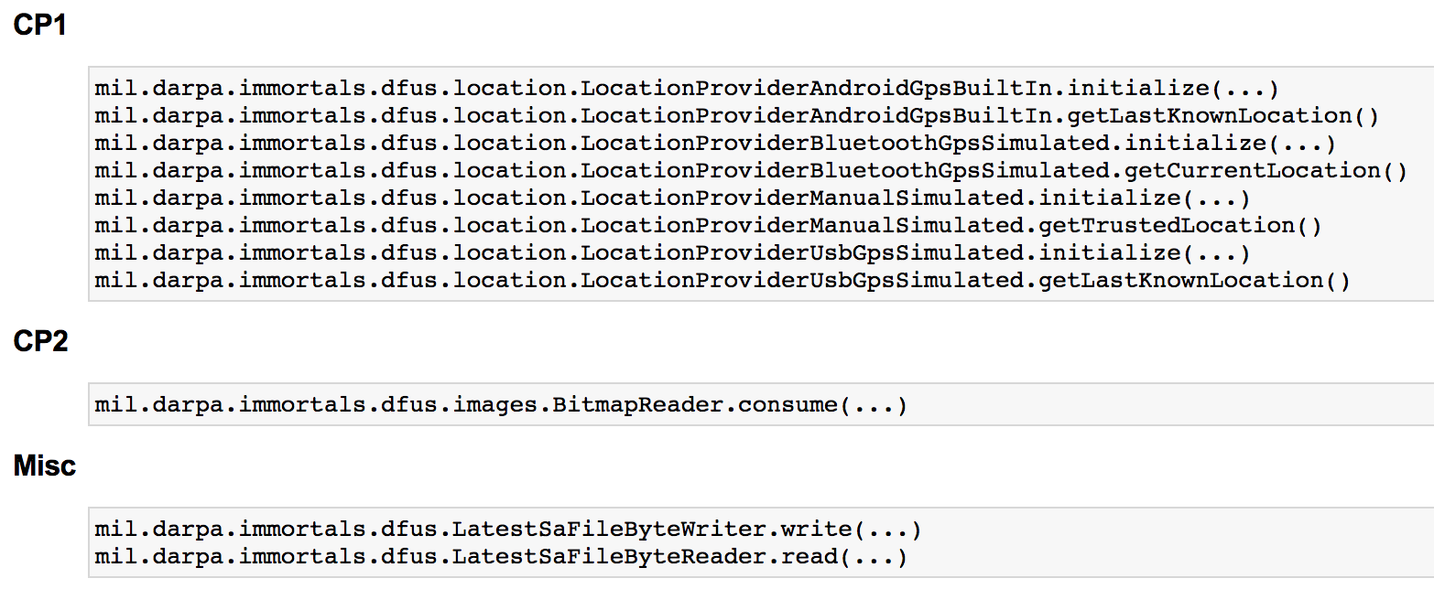
Approach
Resource data transition analysis
Goal: Find out how resource data is transited within application
manually define a list of DFU functions as starting points and end points
starting points: DFU functions that produce the resource data
end points: DFU or non-DFU functions that consume the data
extract a complete call graph and class hierarchy for the whole application
use those extracted info to get all paths from starting to end points

Slide 52
Current Status
Things done:
developed a tool named DroidSIFT to identify hardware resource dependency for GPS satellite and bluetooth
implemented a plugin on top of DroidScope to quantify resource usages for CPU and memory
combined call graph and predefined sources and sinks to understand how resource data is used across different DFUs and non-DFUs
developed an automatic testing environment for executing multiple inputs with different sizes and collected results for analysis
In progress
seeking different techniques to understand the impact of input values
combining the results from above analyses to deliver the resource profiles

Slide 53
Mutation testing work for IMMORTALS
Arpit Christi, Alex Groce
Oregon State University
Feb 2017

Slide 54
Mutation work
Program P -> Mutant P’
Different view of mutant for RASS work
Restricted functionality -> Reduction, Altered functionality -> Replacement
Intuition for RASS – P and P’ can’t be drastically different
Small changes happening at local level, empirical evidence
Annotated (labeled) test suite (manual vs automatic annotations)
Tool for reduction and replacement (only reduction currently)
Usage in both discovery and analytics
Notes:
Intution – Mutant P’ is still useful program that is going to replace original program, It will still execute most of the functionality in more or less similar way, When resource adaptation happens, they cannot be drastically different.

Slide 55
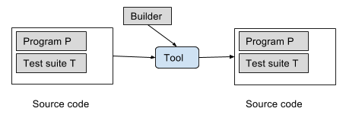
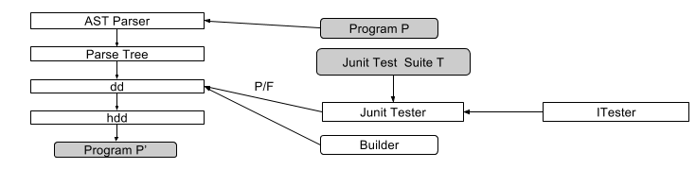
Tool - JReduce
Combines deletion mutation with Hierarchical Delta Debugging (HDD) algorithm
Annotated (labeled) test suite and Program as input
Multiple reduced version of program as output, based on test annotations (labels)
HDD – guarantees minimality and convergence
Leverage existing test suite, minimal pre processing
Factors intuition, early exit criteria possible
Empirical evaluation – tool is widely applicable, changes are small and local (other heuristics?)
Test suite annotations – developer provided or automatically generated
Notes:
Intution – Mutant P’ is still useful program that is going to replace original program, It will still execute most of the functionality in more or less similar way, When resource adaptation happens, they cannot be drastically different.

Slide 56
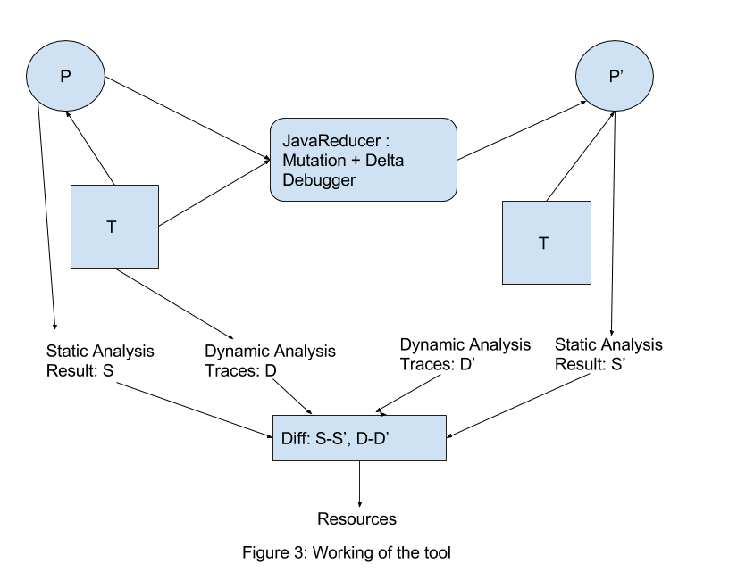
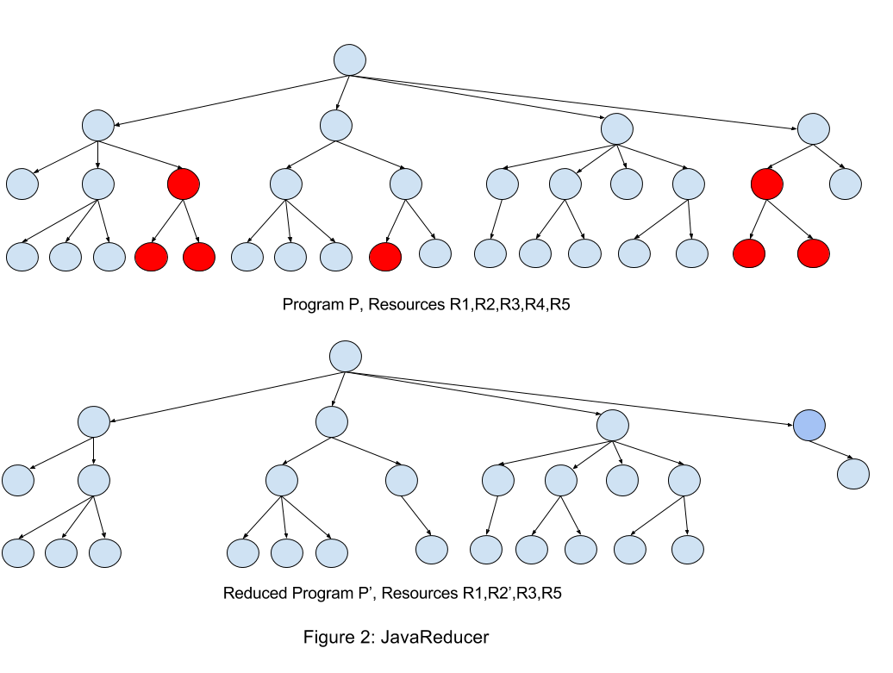
Discovery and analytics
Discovery – Diff of original and mutated Program, diff of static analysis and dynamic analysis results
Analytics – Annotated test suite, resource consumption of tests, Applies reduction and replacement to build new components
Tie everything back to the test suite
Keep pre-computed mutants or generate dynamically
Heuristics to quickly generate mutants
Notes:
Intution – Mutant P’ is still useful program that is going to replace original program, It will still execute most of the functionality in more or less similar way, When resource adaptation happens, they cannot be drastically different.

Slide 57
Research problems
Where does a small change in functionality (restriction or alteration) manifest itself in the program for RASS?
Automating reductions for RASS, leveraging existing test suites
Partially automating replacements
Heuristics: especially more heuristics to enable runtime adaptation.
Effective ways to capture restricted and altered functionality using test suite and empirical analysis.
Runtime testing of adaptations using annotated test suite, Towards Run-Time Testing of Dynamic Adaptive Systems – Fredrericks, Ramirez, Cheng.
Notes:
Intution – Mutant P’ is still useful program that is going to replace original program, It will still execute most of the functionality in more or less similar way, When resource adaptation happens, they cannot be drastically different.

Slide 58
Completed vs ongoing work
Completed
JReduce – tool for reduction
Empirical evaluation of reductions
Some heuristics
few levels from leaf node
Ongoing
Looking for more heuristics + leveraging other methods
Pruning of nodes based on analysis
Bytecode level runtime reductions
Planned
Automatic replacements
Enhancing test suite for adaptation testing
Notes:
Intution – Mutant P’ is still useful program that is going to replace original program, It will still execute most of the functionality in more or less similar way, When resource adaptation happens, they cannot be drastically different.

Slide 59
Phase 1 workshop

Slide 60
Workshop Physical Assets
Logistics
Server/Laptop, VM, Android devices (2-3 enough?)
Wireless access point for connecting real Androids to virtualized environment
Emulation (GPS signal, network, etc.)
Technical
TA4 Interface
Knobs / UI for perturbing environment
Validation (baseline A, baseline B, DAS adaptation)

Slide 61
Workshop Programmatics
Core software is in good shape
Many scenario scripts are geared toward running in the emulation environment
We’ll likely want to evolve that to run in a hybrid emulated+real environment.
We could use better displays in several areas
Visualizing differences between a baseline environment and the perturbed environment
Explaining some of the internal DAS decision making
Today’s demo mimics many aspects of the environment we’ll have for the workshop.

Slide 62
LL Interaction

Slide 63
LL’s API Doc
Calls out three stages of execution:
Baseline Stage A – baseline platform in the baseline environment
All intent tests should pass
Baseline Stage B – baseline platform in perturbed environment
If all intent tests pass, test is inconclusive
What about non-determinism?
Challenge Stage – DAS adapted platform in perturbed environment

Slide 64
LL’s API Doc continued
We have a Test Adapter that can run each of the three stages
LL wanted a REST API that defined a series of action and status messages
We have fully implemented the messages they requested
Awaiting validation against their real Test Harness or an evaluation Test Harness that LL might provide.

Slide 65
General workflow for “offline” adaptation
Perturbed environment+mission requirements are submitted to the DAS (by LL Test Harness)
DAS produces new platform binaries; signal to TH when complete
LL Test Harness signals to begin tests
Our Test Adapter executes the scenario described initially by the TH

Slide 66
Intent Validation Challenge
Intent
At a high level: ATAK Lite clients are able to share SA data
Caveats
SA data published continuously and not all components start/stop at the same instant → correctness check need to allow some slack
Attributes like timeliness require distributed logging, time synchronization, and aggregation – not done in Phase 1, doable with additional TH/TA infrastructure
What kind of SA data or qualities of SA data depends on the mission requirement (e.g., military grade location, location vs images) → “changes” influence “intent”
How to programmatically decide that the DAS did the “right” thing
For each degree of freedom (i.e., mission requirement attribute and environment resource that can change) we have at least one test to check correct operation
Notes:
After explaining the problem/complexity of the concept– the discussion can go into the experience with LL

Slide 67
Intent Validation Implementation
After scenario execution, log analysis is used to evaluate intent tests.
Fixed set of tests (11)
Based on scenario, tests will be required to pass, required to fail, or Not Applicable (don’t care)
Fail: bluetooth-gps test should fail if GPS satellites are unavailable
Pass: The “shared location with other devices” test should always pass
N/A: The “trusted location provider” test might be a “don’t care” if there is no mission requirement for trusted GPS

Slide 68
Scenario Emulation
For validation, we are running our Android applications in emulators
Any external hardware needs to be simulated
We deploy a configuration file to the emulators that describes the hardware that should be simulated
For use in the emulation environment, we need DFUs whose implementation is specific to checking that config file
“Real” versions of DFUs are needed to run on real devices

Slide 69
Overall Experience
Issues encountered
IMMoRTALS’s uniqueness
Pre-deployment changes
Mission requirement changes, in addition to resources
Runtime system (Marti + ATAK light)
Not always a sharp black and white between what will work and what will not
Other than that mostly good, collaborative and helpful

Slide 70
Looking ahead at Phase 2

Slide 71
Phase 2 Technology Push
Discovery side
Input dependency: program analysis + testing
Hidden dependency (through mutation testing)
Dependency and usage of resources such as 3rd party library
Inference/transparency of resource usage
Non-android/server side
Analytics side
Type selection
Handle evolution of database schema
Enhanced program mutation
Replace, Reduce, Compose (add)
Runtime change handling
DAS/Platform
Enhanced evaluation (e.g., efficiency gain/loss of evolved application)
More complex CPs
Model evolution – representation, change propagation
Notes:
Most of the items here are also noted in some way in slide 24 for linkage and continuity.
Here they are grouped in terms of the TAs used in the BAA.
It should also be easy for you to put a performer overlay on top of these.
Note that we have rudimentary instances of replace (DFU substitution), compose (create the scaledImageProducer) and reduce (using mutation testing)– they operate at their own layer (e.g., some at the DFU level, some at the whole program/AST level). In phase 2 we plan to develop a more uniform and systematic coverage of the solution space.

Slide 72
Progression of CPs
Phase 1
Driven by changes in functional and extra functional requirements and constraints
Evaluation is focused on correctness (i.e., it is mostly verification)—no qualitative distinction is made among the possible solutions
Verification is through tests to show that functional intent is preserved
Realized by substitution of components that follow the same usage pattern as baseline
Substitute(s) that could work exists: choose & massage the code
Compose a substitute from available components, and then massage the code
Phase 2
Driven by changes in 3rd party software (OS, Libraries) or services
Evaluation will consider qualitative differences among possible solutions and the one that the DAS produces
Verification is through tests to show that functional intent is preserved
Realized by combination of basic mutations on code: substitute, add (i.e., compose), and remove
Still mostly changes in source code to produce new binaries
Will consider composing simple “controller” code enabling simple runtime behavior adaptation
Will extend the supported patterns of usage
Phase 3
Focused on handling changes encountered at runtime by runtime adaptation
Evaluation will focus on runtime aspects such as time taken to adapt, amount of disruption, level of degradation etc.
Verification is through tests to show that functional intent is preserved
Realized by pre-installed instrumentation in the application that responds to observed runtime changes
Will change the behavior of the application by altering the data and control flow
Will modify the application binary (rewriting or downloading bytecodes)
May adapt (update or modify) the initial instrumentation as well

Slide 73
Demo

Slide 74



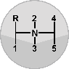

Conceptual Outline
Change Request
Emulated Network
Mission Requirements
Environmental Resources
Mission requirement and resources same as expected by baseline application: deploy and run
Requirement and resources are different: deploy with the new requirement and resource configuration, and run
Run Baseline
Triple Store
Handle Change
Host
Results
Ecosystem
Status Reports
Invoke DAS
IMMoRTALS DAS
TA4 Interface
IMMoRTALS Demo GUI

Slide 75
Demo Overview
“Live” example of CP1 and CP2 together
Run “Baseline Stage A” in emulated environment
Run “Challenge Stage” with a perturbed environment and mission requirements
Keep the ‘real’ devices alive

Slide 76
Demo Notional Scenario
Baseline application assumes GPS, sends images at native camera resolution.
A new set of changes to requirements comes in
Must work in a GPS-denied environment
Must send images
Rate: 1 every 2 seconds
Native image size: 2576x1936
Has severely restricted bandwidth

Slide 77
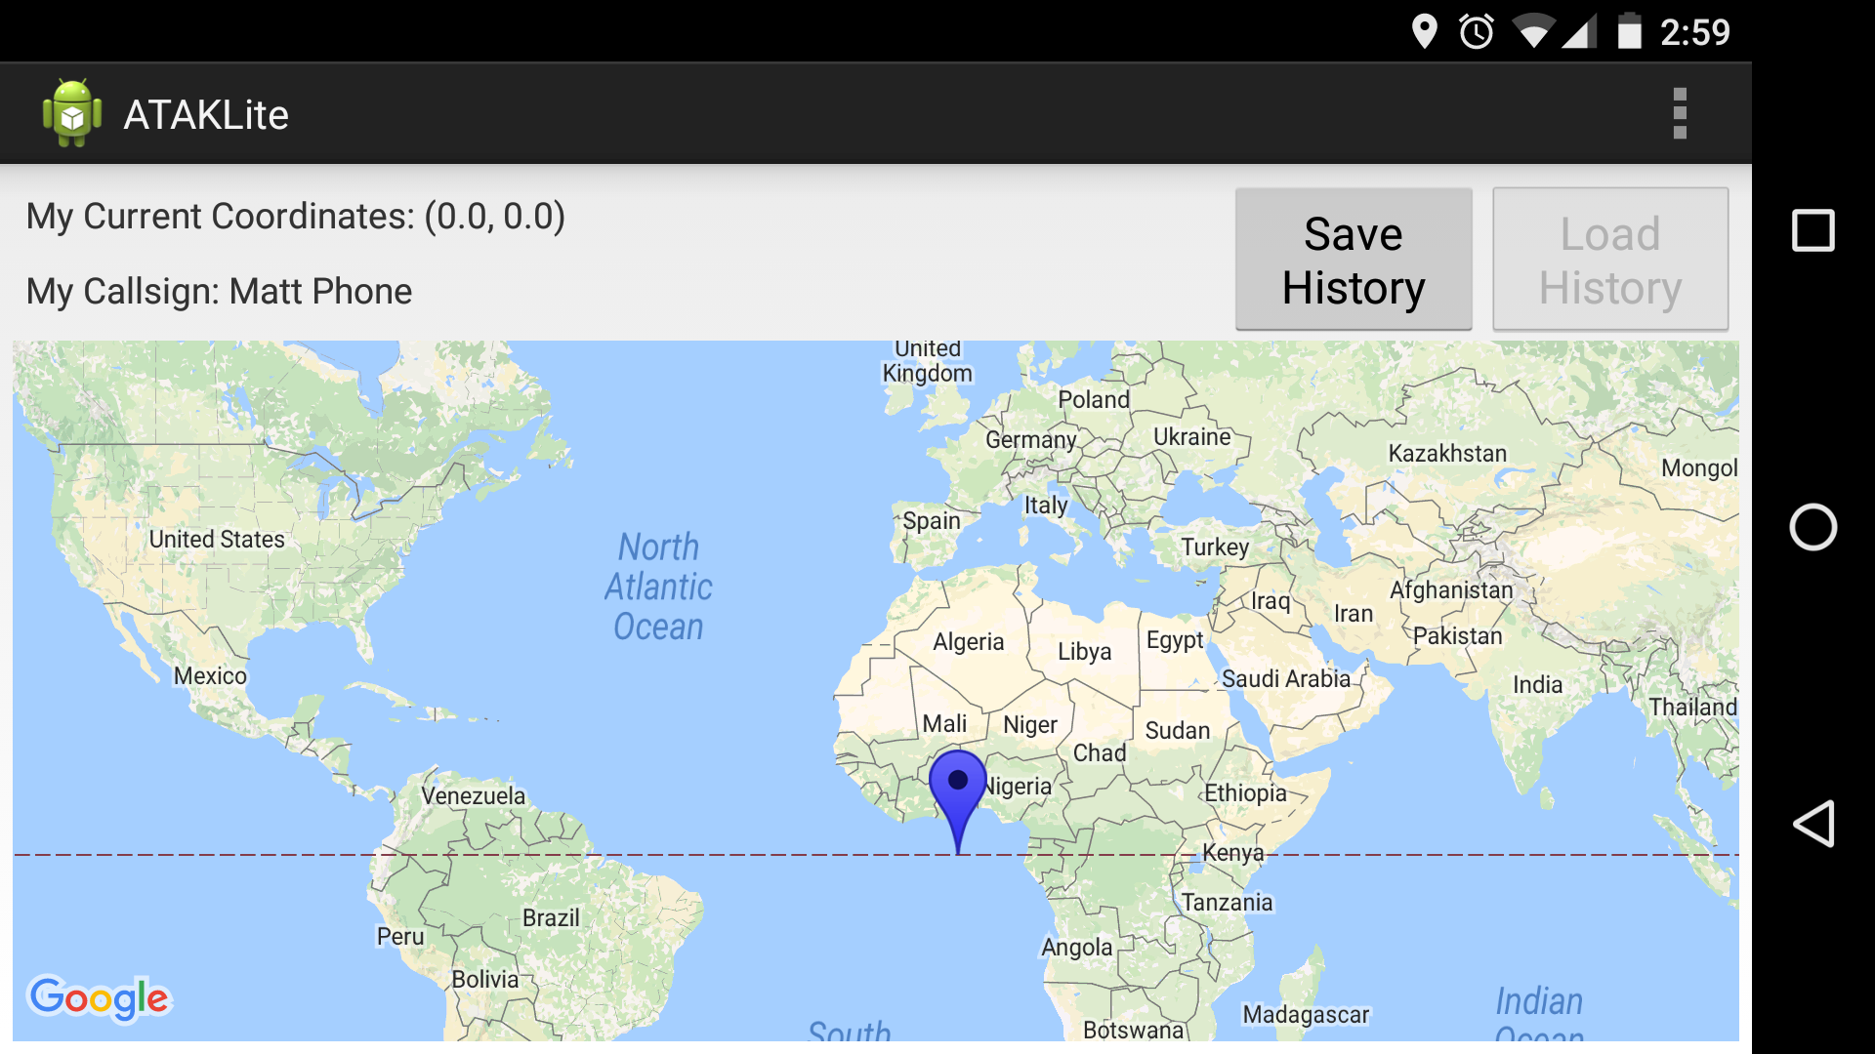
Baseline application

Slide 78
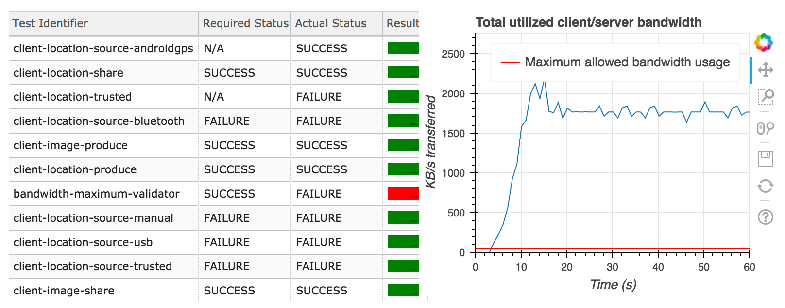
Bandwidth constraint
Baseline-B (Baseline platform)

Slide 79
Preview of results
DAS takes scenario constraints as inputs
DAS determines baseline applications will not work
DAS looks for substitute DFUs
Finds replacement for LocationProvider
none available will relieve the bandwidth constraint
DAS looks to compose a new DFU
Combines ImageScaler with Image Producer DFU
Picks a configuration for ImageScaler

Slide 80
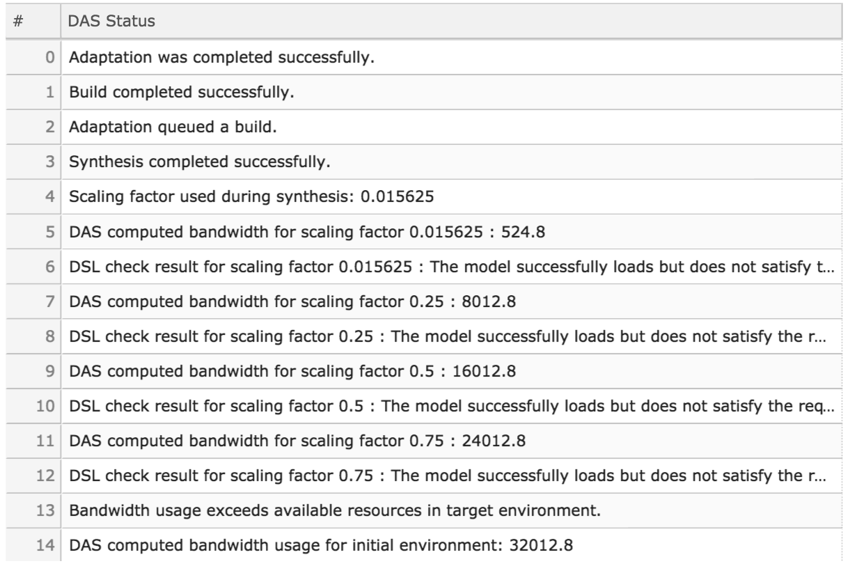
TA4 interface: DAS Status
TH
TA
alt
DAS_ERROR
DAS_READY
TH_ACK/TH_ERROR
adaptAndValidateApplication
TA_ACK/TA_ERROR
optional*
PERTURBATION_DETECTED
TH_ACK/TH_ERROR
alt
MISSION_ABORTED
ADAPTING and/or ADAPTION_COMPLETED
TH_ACK/TH_ERROR
done
TH_ACK/TH_ERROR

Slide 81
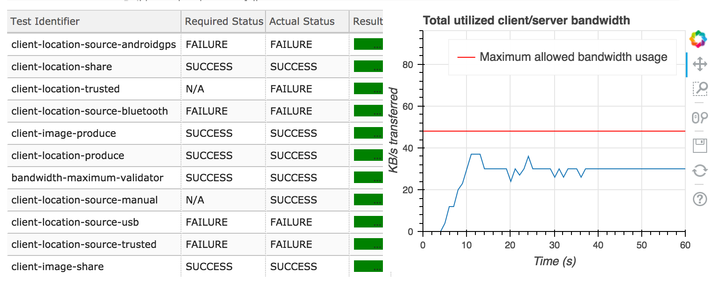
Bandwidth Constraint - Adapted

Slide 82
Linkage to Evaluation
TA4 interface is reasonably complete
REST/programmatic interface for LL
Browser display for demo/workshop purposes
Android Emulation
Scenario execution infrastructure implemented as part of Test Adapter can spin up multiple independent Android Emulators
“Simulated” app fully interoperable with real devices

Slide 83
Tech Transition

Slide 84
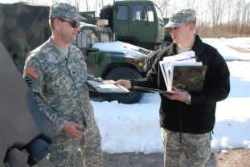
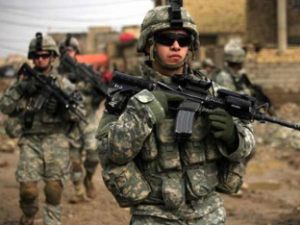


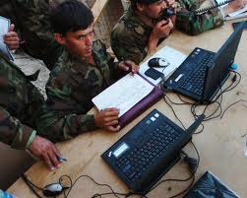
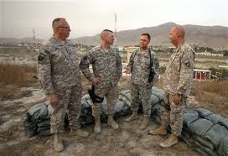




IMMoRTALS is Well Positioned for Transition
Real life SA missions encounter changes frequently; as ATAK/TAKServer developers/maintainers, BBN is well aware of the need and challenges
Number/diversity of sources, volume of and security classification of data, hardware/software capabilities to choose from are increasing rapidly
Mission Planning
Identify Data Sources & Hardware/Software Assets Available
Receive Mission Assignment
Missions are increasingly variable (sanctions, counter-drug, terrorism, insurgency, humanitarian assistance, …)
Share & filter information as required by mission needs & context
Software supporting warfighter must adapt and evolve to function despite dynamic changes in mission focus, data sources, network availability, and environmental conditions
Warfighters must be able to analyze solutions & improve them throughout the lifecycle
Analyze & report completed mission
Mission Analysis
Warfighters must have confidence to use & share adapted solutions in mission-critical contexts
Tailor & use mission-specific operational picture
Mission Execution

Slide 85
Potential Users
Program Managers
Help in planning development tasks, without the need for pesky developers
Does not make use of the full DAS, especially components responsible for generating the variants, building and testing
Developers
Finding potential sources of needed functionality
Illustrating cascading effects of changes
They could potentially use the DAS as a whole but are likely to have their own build and test environment
Deployment or Mission Managers / End Users (owners of mission requirements)
Determine if current apps would work in a given scenario
They also could use the entire DAS – but may not have enough technical background
Take aways
Analysis and visualization of the extracted knowledge seems most likely to be used
Enhancing usability is all about understanding and bridging the impedance gap between what we have and what the intended user can use

Slide 86
Transition Targets
Lessons learned from the past as both technology developer and the ATAK/TAKServer developer
The need for new capability varies from one constituent to another (e.g., PMs, Developers, End users)
R&D and experimental capabilities have many moving parts and it is hard and rare to transition the whole system
Better to try incrementally narrow/focused capability matched to a specific constituency

Slide 87
Transition Options
Self-contained capabilities
Discovery tools (Custom plugins for DroidScope, etc.)
GME
Getting an R&D product transitionable
Earning confidence of the transition target (evaluation, demos)
Packaging and robustness of the code
Presentation/UI – the users are not usually the expert developers or computer scientists
May need additional specialized development for generalization, robustness

Slide 88
Usability

Slide 89
Usability: Audience
Who could potentially use IMMoRTALS
Maintainers of the ATAK/TAK Server
Program managers/Mission Managers
Developers feeding to the ATAK food chain
End users
They are not likely to use the entire set of capabilities of IMMoRTALS as a whole
Their usability requirements may also be different
End users would need a UI at the level of mission requirements
Developers might want interfaces to browse the KR

Slide 90
Consider the ATAK/TAKServer Maintainers
Potential uses
Help with building up the semantic model (by using annotations)
Help with building up the dependency and resource usages (program analysis, automation)
Managing domain model
What are the issues that can hinder usability
There is still a gap between what humans conceive in terms of the mission requirements and how it is represented in the system
Is there an analog for environment changes

Slide 91
Usability: A Concrete Idea
GME provides a UI for describing the environment
Mission Requirements
Physical deployment aspects
Potential for encoding constraints in model (i.e., to allow DSL to evaluate constraints that were not envisioned)
Enrich the KR
Facilitate more and more accurate semantic and resource specification and dependency knowledge in the KR

Slide 92
Conclusion, Action Items

Slide 93
Summary
Good progress and momentum in the 1st year
Lots of interesting challenges and possibilities
Related ideas for future R&D that are not closely aligned with IMMoRTALS or BRASS
Team has demonstrated flexibility and adaptability (faculty moves, etc.)
Great support from DARPA and AFRL
Looking forward to the platform workshop and Phase 2
Comments, guidance?

